Slide 1
The Language web app
By Simon Chen

Slide 2
Content
Introduction
CI Pipeline
Documentations
Trello
Expectation vs Reality
Sequence diagram and user stories
Live Demonstration
Test and Coverage
Future Development
Summary

Slide 3
Introduction
Brief
Two tables with CRUD (Create, Read, Update, and Delete) functionality
Functional front-end website and integrated APIs made with Flask
Test the app and show the coverage
What does the app do?
This language app allows the users to input English-Spanish translations and place it into a table, so that they can use it to storage the translations they want to learn and modify it as they desire

Slide 4
Continuous Integration (CI) Pipeline
Project management style- agile
Software used in this project
Jenkins- CI server
Google Cloud Platform (GCP)- Cloud server
Trello- Project Management tool/Kanban board
Github- git repository
Flask- micro-framework
Git- VCS
GCP MySQL server- database
Programming languages used
Python
HTML
Linux

Slide 5


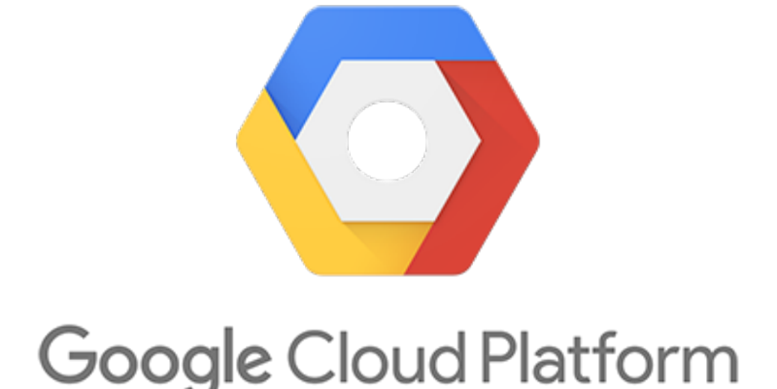







Development VM
Webhook
Push

Slide 6
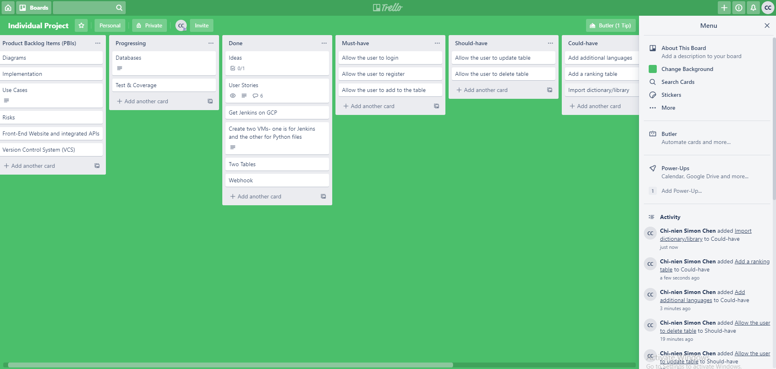
Trello

Slide 7
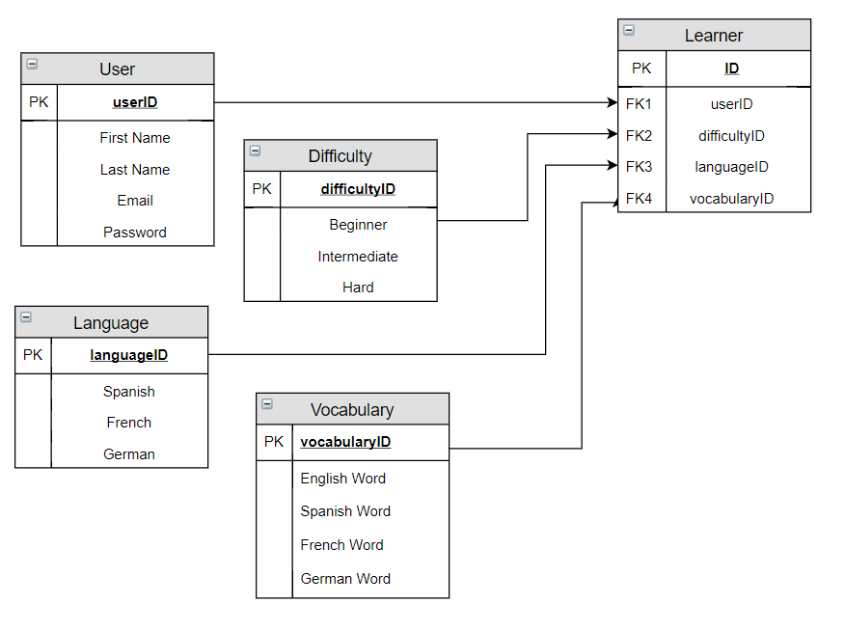
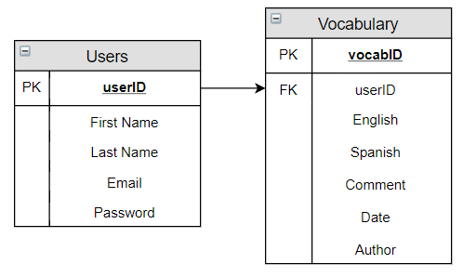
Expectation vs Reality
The initial idea was to make five tables: Users, Vocabulary, Difficulty, Language, and Learner.
However due to time constraint, this was reduced to two simple tables: Users and Vocabulary.

Slide 8
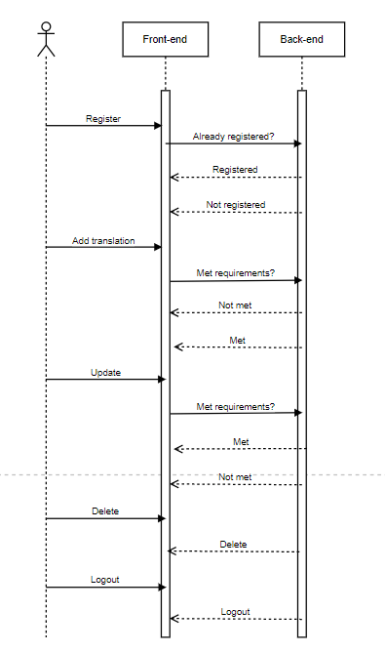
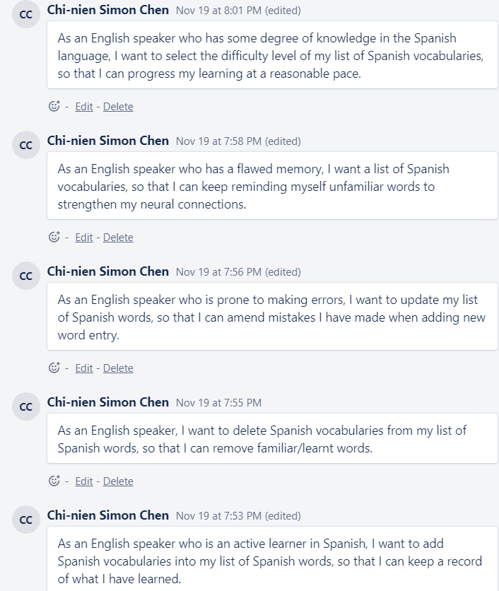
Sequence Diagram & User Stories

Slide 9
Live Demonstration
It’s show time!
http://35.234.153.63:8001/register

Slide 10
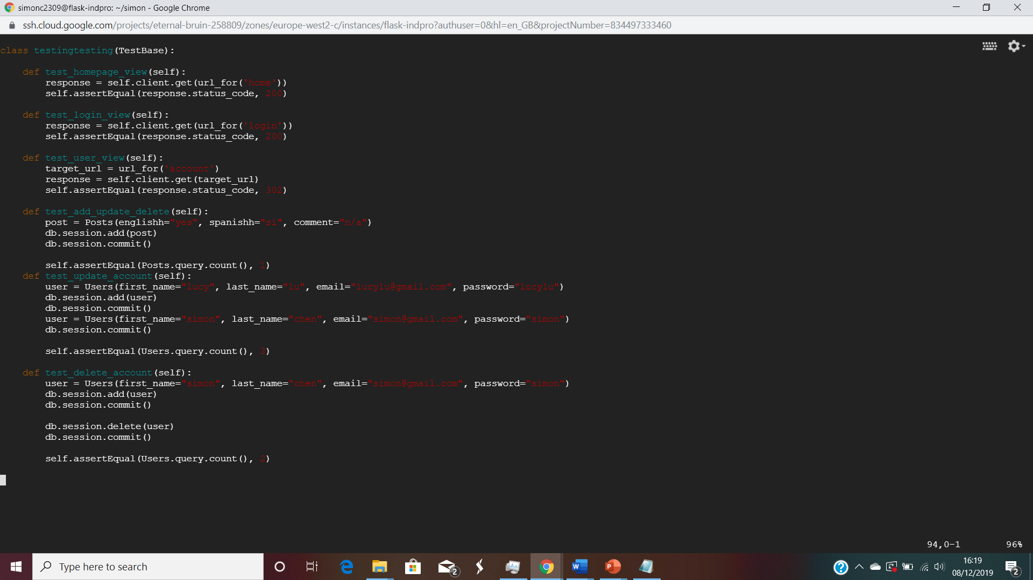
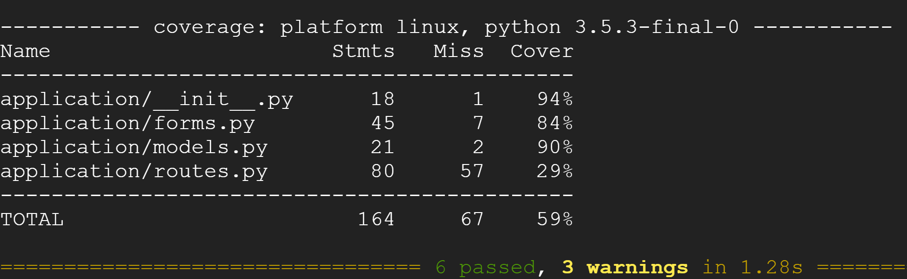
Test and Coverage
Six tests were carried out. All passed with 59% coverage.

Slide 11
Future Development
Introducing more features and functionalities into the app by:
Implement update and delete features for table
Offer more languages
Offer to speakers other than English
Import dictionary/library of words,
Improvement of front-end design
Difficulty level
Ranking

Slide 12
Summary
Throughout the five weeks with QA Consulting, I have learned the CI pipeline and put the knowledge into use, which led to the creation of this project
The result product is a functioning website that allows the user to create and read the table entry, and update and delete the account.
It was interesting to see how all the things that had been taught come together in developing an application.

Slide 13

Thank you for listening
Are there any questions?

